Slide 1
Lecture 3 Dr. Suha K. Shihab
Melting And Pouring Of The Liquefied Metal
To perform a casting operation, the metal must be heated to a temperature somewhat above its melting point and then poured into the mold cavity to solidify.
Heating The Metal
Heating furnaces of various kinds are used to heat the metal to a molten temperature sufficient for casting. The heat energy required is the sum of:
(i) the heat to raise the temperature to the melting point,
(ii) the heat of fusion to convert it from solid to liquid,
(iii) the heat to raise the molten metal to the desired temperature for pouring.
This can be expressed:
H = total heat required to raise the temperature of the metal to the pouring temperature, J
ρ = density, g/cm³
V = volume of metal being heated, cm³
Cs = weight specific heat for the solid metal, J/gºC
C_{l} = weight specific heat of the liquid metal, J/gºC
T_{m} = melting temperature of the metal, ºC
T_{o} = starting temperature-usually ambient, ºC
H_{f} = heat of fusion, J/g
T_{p} = pouring temperature, ºC

Slide 2
Lecture 3 Dr. Suha K. Shihab
Use of above Eq. is complicated by the following factors:
1. Specific heat and other thermal properties of a solid metal vary with temperature, especially if the metal undergoes a change of phase during heating.
2. A metal’s specific heat may be different in the solid and liquid states.
3. Most casting metals are alloys, and most alloys melt over a temperature range between a solidus and liquidus rather than at a single melting point; thus, the heat of fusion cannot be applied so simply as indicated above.
4. The property values required in the equation for a particular alloy are not readily available in most cases.
5. There are significant heat losses to the environment during heating.
Example:
One cubic meter of a certain eutectic alloy is heated in a crucible from room temperature to 1000 ºC above its melting point for casting. The alloy’s density = 7.5 g/cm³, melting point = 800 ºC, specific heat = 0.33 J/gºC in the solid state and 0.29 J/gºC in the liquid state; and heat of fusion = 160 J/g. How much heat energy must be added to accomplish the heating, assuming no losses?
Solution:
We assume ambient temperature in the foundry = 25 ºC and that the density of the liquid and solid states of the metal are the same. Noting that one m³ = 10⁶ cm³
H = 7.5 (10⁶){0.33(800 -25) + 160 + 0.29(1000-800)} = 3335 (10⁶) J

Slide 3
Lecture 3 Dr. Suha K. Shihab
Pouring the Molten Metal
Pouring is the introduction of molten metal into the mold, including its flow through the gating system and into the cavity.
For this step to be successful, the metal must flow into all regions of the mold before solidifying. Factors affecting the fluidity of a molten metal during pouring into a mold cavity include:
pouring temperature, (2) pouring rate, and (3) turbulence.
1. pouring temperature is the temperature of the molten metal as it is introduced
into the mold.
The important thing here is the superheat which is the difference between the temperature at pouring and the temperature at which freezing begins (the melting point for a pure metal
or the liquidus temperature for an alloy). This term is also used for the amount of heat that must be removed from the molten metal between pouring and when solidification commences
2. Pouring rate refers to the volumetric rate at which the molten metal is poured into the mold.
If the rate is too slow, the metal will chill and freeze before filling the cavity. If the pouring rate is excessive, turbulence can become a serious problem.
3. Turbulence in fluid flow is characterized by erratic variations in the magnitude and direction of the velocity throughout the fluid.

Slide 4


Lecture 3 Dr. Suha K. Shihab
Turbulent flow should be avoided during pouring for several reasons:
1. It tends to accelerate the formation of metal oxides, thus degrading the quality of the casting.
2. It aggravates Mold erosion, the gradual wearing away of the mold surfaces due to impact of the flowing molten metal.
3. The geometry of the cast part is affected when the erosion is occurred in the main cavity.
ENGINEERING ANALYSIS OF POURING
There are several relationships that govern the flow of liquid metal through the gating system and into the mold. An important relationship is Bernoulli’s theorem:
h= head
v = flow velocity
g = gravitational acceleration constant
Another relationship of importance during pouring is the continuity law, which states that the volume rate of flow remains constant throughout the liquid.
Q = v₁ A₁ = v₂A₂
where Q = volumetric flow rate; v = velocity cm³/s ; as before; A = cross sectional area of the liquid, cm² ; and the subscripts refer to any two points in the flow system. Thus, an increase in area results in a decrease in velocity, and vice versa.
The time required to fill a mold cavity of volume V is calculated from:

Slide 5
Lecture 3 Dr. Suha K. Shihab
Example:
A mold sprue is 20 cm long, and the cross-sectional area at its base is 2.5 cm². The sprue feeds a horizontal runner leading into a mold cavity whose volume is 1560 cm³. Determine: (a) velocity of the molten metal at the base of the sprue, (b) volume rate of flow, and (c) time to fill the mold.
Solution:
(a) The velocity of the flowing metal at the base of the sprue is:
where h= long of sprue, cm; g= 981 cm/s² (gravitational acceleration constant)
(b) The volumetric flow rate is
Q = v₁ A₁ = v₂A₂
Q = (2.5 cm² ) (198:1 cm/s) = 495 cm³/s
(c) Time required to fill a mold cavity of at this flow rate is
T_{MF} =1560/495 = 3.2s

Slide 6
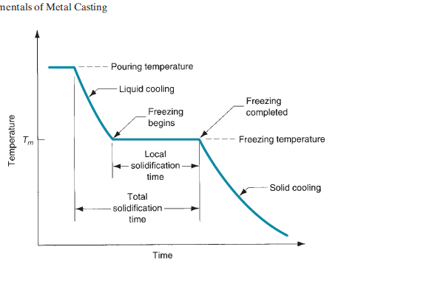
Lecture 3 Dr. Suha K. Shihab
SOLIDIFICATION OF METALS
Solidification involves the transformation of the molten metal back into the solid state.
The solidification process differs depending on whether the metal is a pure element or an
alloy.
A pure metal solidifies at a constant temperature equal to its freezing point, which is the same as its melting point. The process occurs over time as shown in the cooling curve for a pure metal during casting(Fig.1):
Local solidification time is the time required for actual freezing in casting, during which the metal’s latent heat of fusion is released into the surrounding mold.
Total solidification time is the time taken between pouring and complete solidification.
After the casting has completely solidified, cooling continues at a rate indicated by the downward slope of the cooling curve.
Figure 1: Cooling curve for a pure metal during casting.

Slide 7
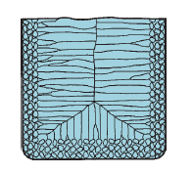
Lecture 3 Dr. Suha K. Shihab
A thin skin of solid metal is initially formed at the interface immediately after pouring. because of the chilling action of the mold wall. Thickness of the skin increases to form a shell around the molten metal as solidification progresses inward toward the center of the cavity. The rate at which freezing proceeds depends on heat transfer into the mold, as well as the thermal properties of the metal.
The metal which forms the initial skin has been rapidly cooled by the extraction of heat through the mold wall. This cooling action causes the grains in the skin to be fine and randomly oriented.
As cooling continues, further grain formation and growth occur in a direction away from the heat transfer. Since the heat transfer is through the skin and mold wall, the grains grow inwardly as needles or spines of solid metal. As these spines enlarge, lateral branches form, and as these branches grow, further branches form at right angles to the first branches. This type of grain growth is referred to as dendritic growth.
The grains resulting from this dendritic growth take on a preferred orientation, tending to be coarse, columnar grains aligned toward the center of the casting.
Fig.2 showing randomly oriented grains
of small size near the mold wall, and
large columnar grains oriented
toward the center of the casting.
Figure 2 Characteristic grain structure in a casting of a pure metal,

Slide 8
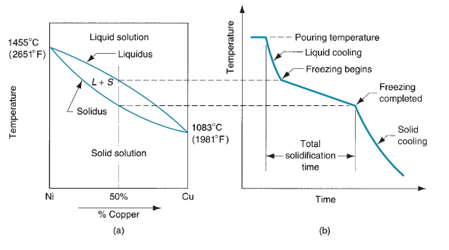
Lecture 3 Dr. Suha K. Shihab
Most alloys freeze over a temperature range rather than at a single temperature. The exact range depends on the alloy system and the particular composition.
Solidification of an alloy can be explained with reference to below Fig.3:
Figure 3 (a) Phase diagram for a copper– nickel alloy system and
(b) associated cooling curve for a 50%Ni–50%Cu composition during casting.
As temperature drops, freezing begins at the temperature indicated by the liquidus and is completed when the solidus is reached. The start of freezing is similar to that of the pure metal. A thin skin is formed at the mold wall due to the large temperature gradient at this surface.
Freezing then progresses as before through the formation of dendrites that grow away from the walls.

Slide 9
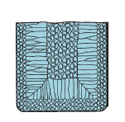
Lecture 3 Dr. Suha K. Shihab
However, owing to the temperature spread between the liquidus and solidus, the nature of the dendritic growth is such that an advancing zone is formed in which both liquid and solid metal coexist. The solid portions are the dendrite structures that have formed sufficiently to trap small islands of liquid metal in the matrix. This solid–liquid region is called mushy zone.
Depending on the conditions of freezing, the mushy zone can be relatively narrow, or it can exist through outmost of the casting. mushy zone is promoted by factors such as: (i) slow heat transfer out of the hot metal and (ii) a wide difference between liquidus and solidus temperatures
As freezing continues and the dendrites grow, there develops an imbalance in composition between the metal that has solidified and the remaining molten metal. This composition imbalance is finally manifested in the completed casting in the form of segregation of the elements.
Figure 4 Characteristic grain structure in an alloy
casting, showing segregation of alloying components in the center of casting.

Slide 10
Lecture 3 Dr. Suha K. Shihab
The segregation is of two types:
1. Microscopic level
The chemical composition varies throughout each individual grain due to the fact that the beginning spine of each dendrite has a higher proportion of one of the elements in the alloy. Thus, we have a variation in chemical composition within single grains of the casting.
2. Macroscopic level:
The chemical composition varies throughout the entire casting. Since the regions of the casting that freeze first (at the outside near the mold walls) are richer in one component than the other, the remaining molten alloy is deprived of that component at the interior. Thus, there is a general segregation through the cross-section of the casting sometimes called ingot segregation, as illustrated in Figure 4..

Slide 11

Lecture 4 Dr. Suha K. Shihab
Solidification Time
The total solidification time is the time required for the casting to solidify after pouring. This time is dependent on the size and shape of the casting by an empirical relationship known as Chvorinov’s rule, which states:
T_{TS} =total solidification time, min;
V= volume of the casting, cm³ ;
A = surface area of the casting, cm² ;
n is an exponent usually taken to have a value = 2; and
C_{m} is the mold constant, min/cm²
mold constant value depends on the conditions of the casting operation, including :
mold material (e.g., specific heat, thermal conductivity),
thermal properties of the cast metal (e.g., heat of fusion, specific heat, thermal conductivity),
pouring temperature relative to the melting point of the metal.
Chvorinov’s rule indicates that a casting with a higher volume-to-surface area ratio will cool and solidify more slowly than one with a lower ratio

